Slide 1

Startup Starter
Launch Your Startup: From Idea to Market Value
Dr. Erik Guzik

Slide 2
Schedule
Week 1 – Nov 12: Finding Your Idea or Opportunity Discover how to spot market gaps and refine your business concept.
Week 2 – Nov 19: Testing Your Idea (Customer Development) Learn how to validate your idea through real-world feedback.
Week 3 – Tues, Nov 25: Reaching Your Customers (Marketing & Sales) Build a marketing plan that connects your product with your audience.
Week 4 – Dec 3: Your Business Model & Financials
Design a business model that works and understand the numbers behind it.
Week 5 – Dec 10: Pitching Your Idea
Create your pitch deck and practice your delivery.
Final Event – Thurs, Dec 11: Pitch Showcase to small group of
decision-makers @ WCU

Slide 3
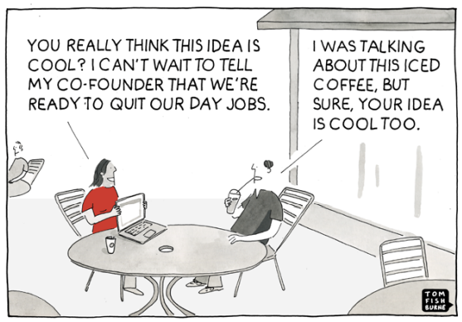

Slide 4
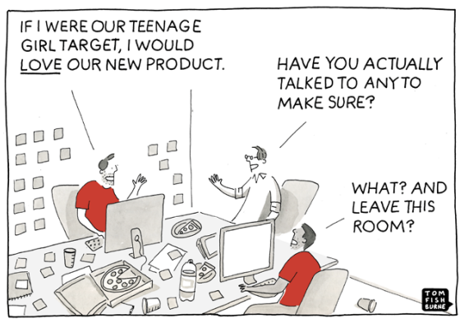

Slide 5
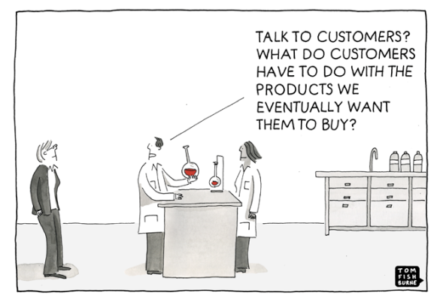

Slide 6
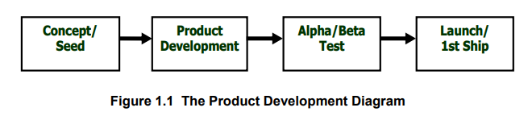
Product Development

Slide 7
Verifying Need for Your Idea (Demand)

Slide 8

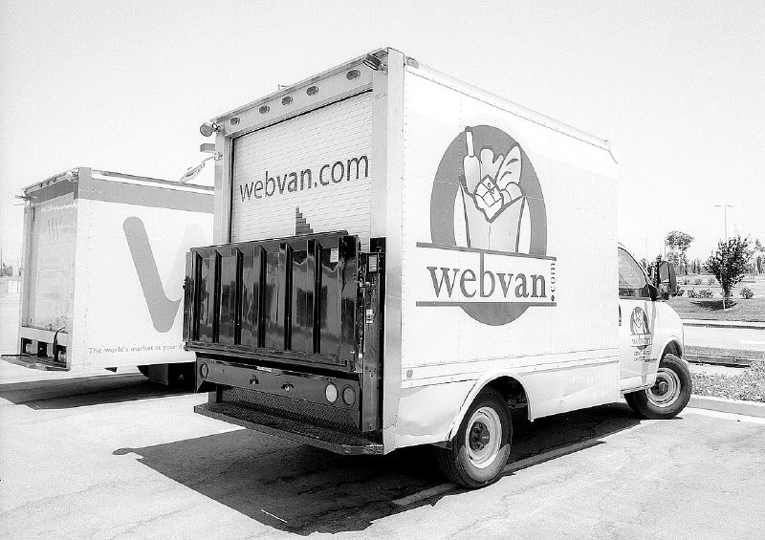

Slide 9
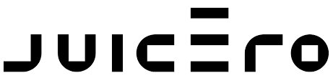
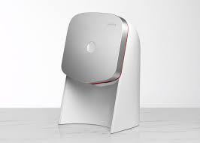
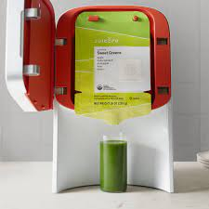
Purpose: Quick and easy juicer
Product: Like Keurig, but for juice.
User: Health-conscious consumers, who really, really like fresh juice
PROS
Healthy (market trend)
Sleek design
Wi-fi
Mobile app (QR code)
Raised $120M

Slide 10
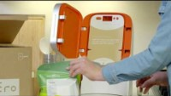
https://www.youtube.com/watch?v=-i0UugILBJg

Slide 11
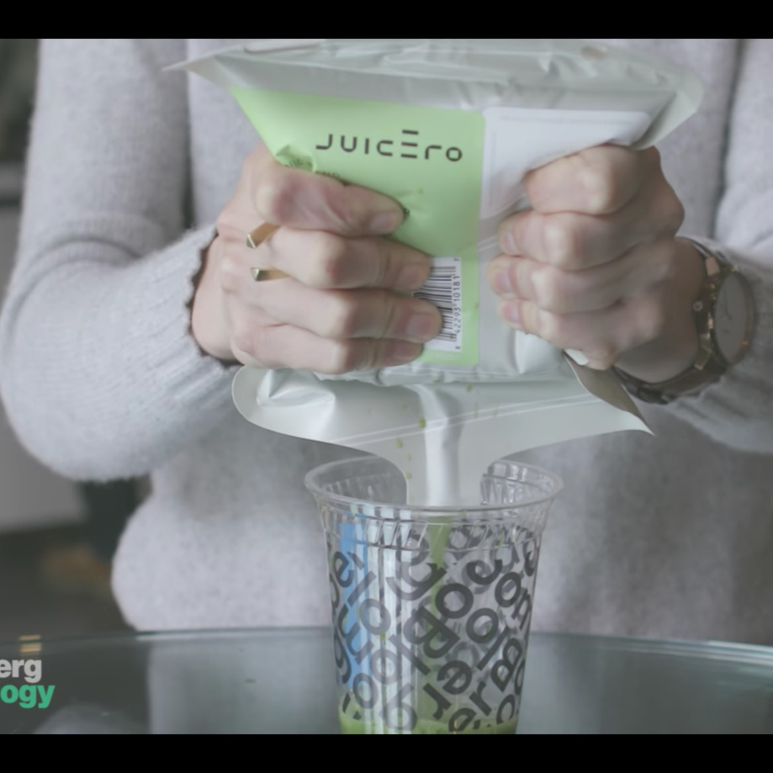


Slide 12
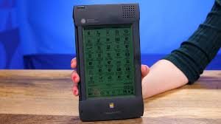

Slide 13
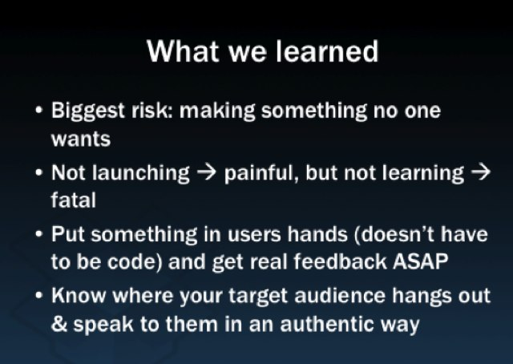


Slide 14
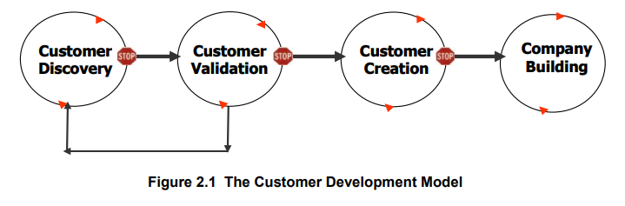
Customer Development

Slide 15
Product < > Customer

Slide 16
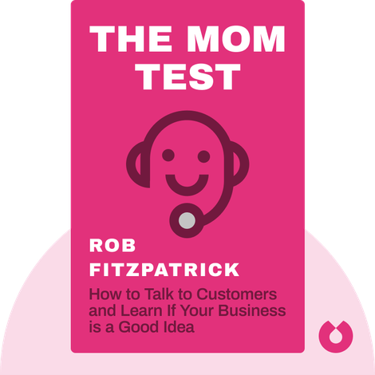

Slide 17
CRITICAL STEP: “Talking to humans.” Get out of the building.
Research the Idea. Validate the Idea.
Ask potential users (future customers) questions:
Problems they face
Products they like and don’t like
How a product or service could be improved
Solutions customers now use
Feedback on your MVP
What surprised you (the unexpected).

Slide 18
Minimum viable product (MVP): A very early (and inexpensive) model or prototype of a product.
Bare minimum to help people understand what the product is about.
An actual product isn’t even required; can be represented in sketches, videos, and explanations of how it might look or work.
Example:
Zappos started with photos on a webpage.
Dropbox didn’t even begin with an app—they posted a video of what the app would do.
Spotify started with a sketch.

Slide 19
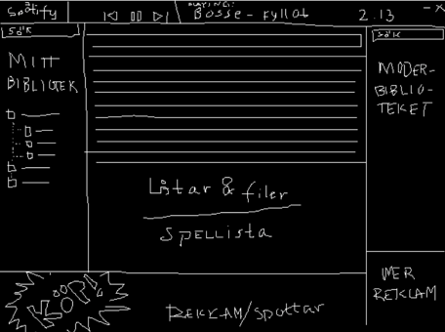

Slide 20
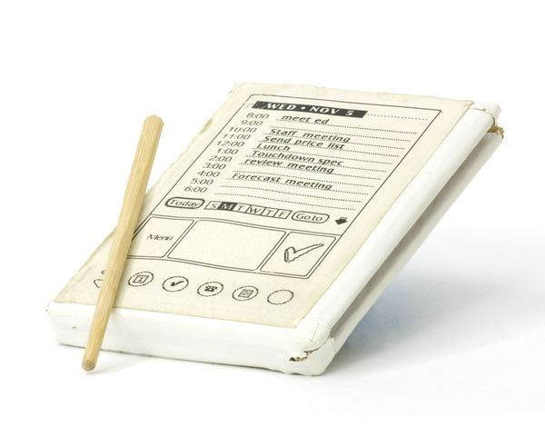

Slide 21
A very basic version of the product, like the LinkedIn or Moodle web applications, which were really, really bad.
A basic product to show to potential users, with enough substance to elicit feedback on what people find useful (NEED) and what attributes are important without having to invest a lot of money and time.
There is no right or wrong type of MVP. Purpose: Test idea to find out if there is demand for your solution, and how to take the idea to the next level.

Slide 22
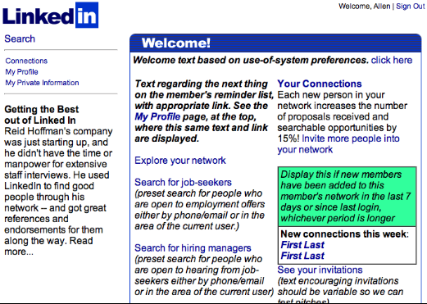

Slide 23
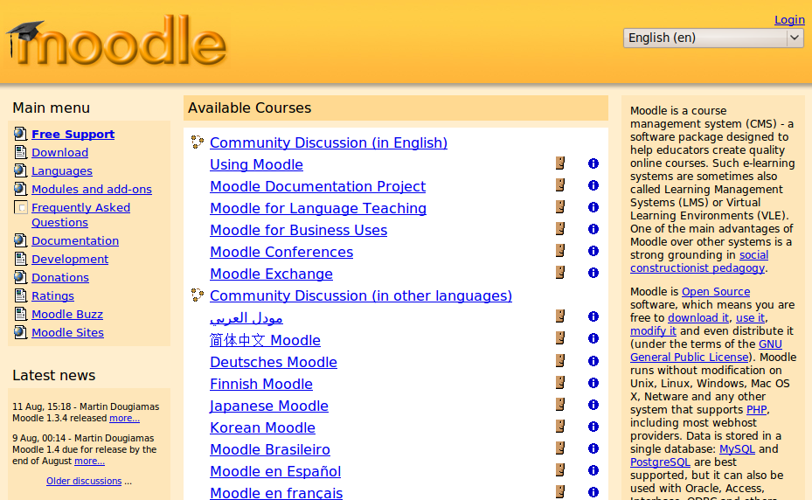

Slide 24
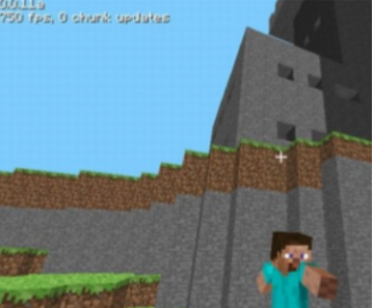
Bonus: Sometimes the MVP IS the product.

Slide 25
Designing Your MVP
Consider your solution. What type of MVP could you create to help demo your idea to users and get better feedback? Brainstorm 5 ideas about how your MVP could look/act/feel.
Spotify: Sketch idea on paper
Crumble Cookies: Setup taste testing table on campus or at truck stops.
Bayern: Setup brewing at the Iron Horse.
Setup table at Out to Lunch
Setup pilot at Whitefish Credit Union
Go through your list and select one MVP that you think is most feasible: it can be built quickly and get you some type of important feedback required for moving your idea forward (usability, demand, verifying problem, etc.).
Discuss your proposed MVP with a partner. We will share our ideas with the workshop.

Slide 26
Customer Discovery
Your homework: Develop a simple MVP.
What does your solution do? What problem does it solve?
Create an MVP using sketches, design software, handouts, a pilot, a small gathering of people, a test meetup, etc.
Demo your MVP to 5-7 potential users. Document their reactions. Show them the purpose of your solution and be sure to explain the problem it solves. Document anything that surprises you.
Report back to the workshop next Tuesday with your results.

